Slide 1
Applied Physics(C. Sc.) BS CS Semester-I Course Code: L-3(Newton’s Laws of Motion) IUB & All Affiliated Colleges. Reality Awards Boost Up (YT-Channel)
Rushmat Ali
Assistant Professor OF Physics
Govt. Kh. F. Graduate College R. Y. Khan

Slide 2
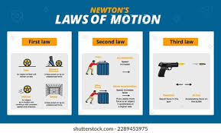
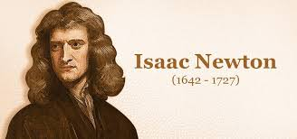
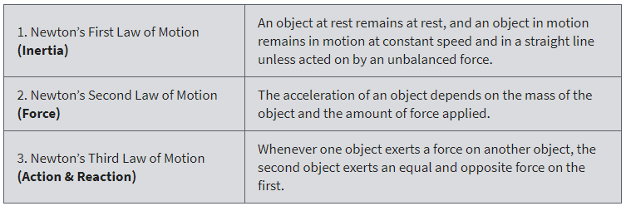
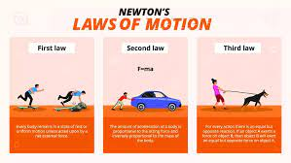

What are Newton’s Laws of Motion?
Sir Isaac Newton worked in many areas of mathematics and physics.
He developed the theories of gravitation in 1666 when he was only 23 years old.
In 1686, he presented his three laws of motion in the “Principia Mathematica Philosophiae Naturalist.”
By developing his three laws of motion, Newton revolutionized science.
Newton’s laws together with Kepler’s Laws explained why planets move in elliptical orbits rather than in circles.

Slide 3
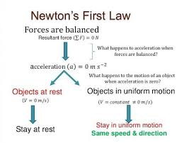
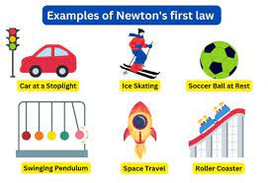
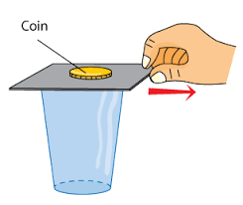
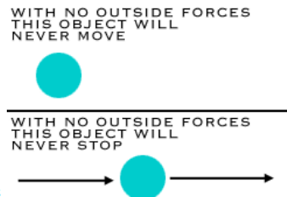
Newton’s First Law: Inertia
An object at rest remains at rest, and an object in motion remains in motion at constant speed and in a straight line unless acted on by an unbalanced force.
Newton’s first law states that every object will remain at rest or in uniform motion in a straight line unless compelled to change its state by the action of an external force.
This tendency to resist changes in a state of motion is inertia. If all the external forces cancel each other out, then there is no net force acting on the object.
If there is no net force acting on the object, then the object will maintain a constant velocity.
Examples of inertia involving aerodynamics:
The motion of an airplane when a pilot changes the throttle setting of an engine.
The motion of a ball falling down through the atmosphere.
A model rocket being launched up into the atmosphere.
The motion of a kite when the wind changes

Slide 4
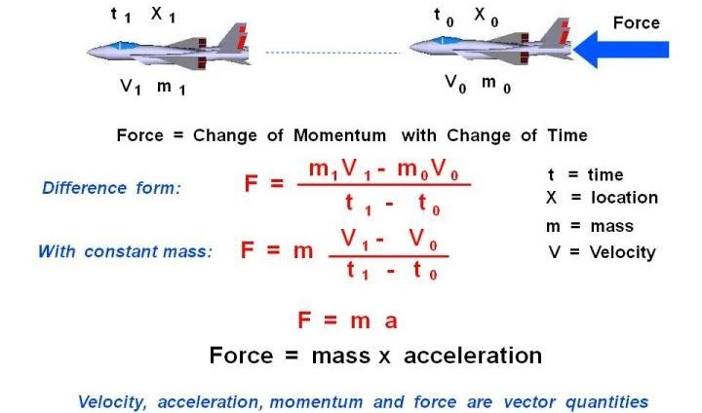
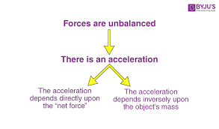
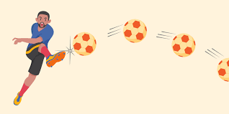
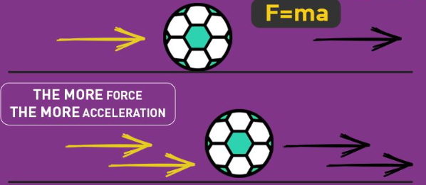
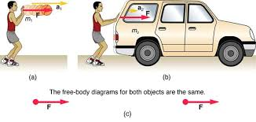

Newton’s Second Law: Force
There are two forms of this law:
When an unbalanced external force acts on a body, it produces an acceleration in its own direction. Such that magnitude of acceleration is directly proportional to magnitude of for and inversely proportional to mass of the object. Mathematically, F=ma. Here m is constant mass.
The time rate of change of momentum is equal to applied force. $\vec{F }=\frac{∆\vec{p}}{∆t}$, Here, p=mv= momentum. It is applied when mass and velocity both changes in rockets.
Let us assume that we have an airplane at a point “0” defined by its location X0 and time t0. The airplane has a mass m0 and travels at velocity V0. An external force F to the airplane shown above moves it to point “1”. The airplane’s new location is X1 and time t1.
The mass and velocity of the airplane change during the flight to values m1 and V1. Newton’s second law can help us determine the new values of V1 and m1, if we know how big the force F is. Let us just take the difference between the conditions at point “1” and the conditions at point “0”.
The change in velocity divided by the change in time is the definition of the acceleration a. The second law then reduces to the more familiar product of a mass and an acceleration:
Example of force involving aerodynamics:
An aircraft’s motion resulting from aerodynamic forces, aircraft weight, and thrust

Slide 5
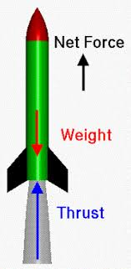
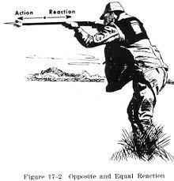
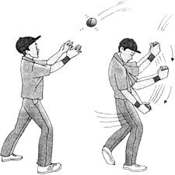
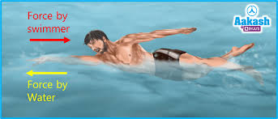
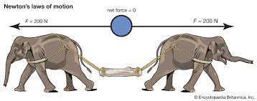
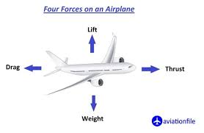
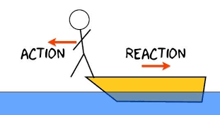
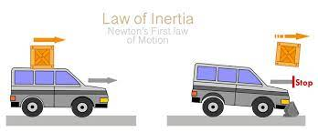

Newton’s Third Law: Action & Reaction
Whenever one object exerts a force on a second object, the second object exerts an equal and opposite force on the first.
His third law states that for every action (force) in nature there is an equal and opposite reaction. $\vec{F12}=−\vec{F21}$ This pair of forces do not exerts on the same body.
If object A exerts a force on object B, object B also exerts an equal and opposite force on object A. In other words, forces result from interactions.
Examples of action and reaction involving The motion of a spinning ball, the air is deflecteaerodynamics:
The motion of lift from an airfoil, the air is deflected downward by the airfoil’s action, and in reaction, the wing is pushed upward.
d to one side, and the ball reacts by moving in the opposite direction.
The motion of a jet engine produces thrust and hot exhaust gases flow out the back of the engine, and a thrusting force is produced in the opposite direction.

Slide 6
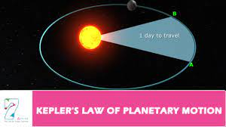
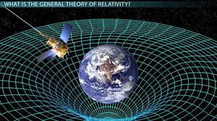
Influence of Newton’s laws
Newton’s laws first appeared in his masterpiece, Philosophiae Naturalis Principia Mathematica (1687), commonly known as the Principia.
In 1543 Nicolaus Copernicus suggested that the Sun, rather than Earth, might be at the centre of the universe.
In the intervening years Galileo, Johannes Kepler, and Descartes laid the foundations of a new science that would both replace the Aristotelian worldview, inherited from the ancient Greeks, and explain the workings of a heliocentric universe.
In the Principia Newton created that new science. He developed his three laws in order to explain why the orbits of the planets are ellipses rather than circles, at which he succeeded, but it turned out that he explained much more.
The series of events from Copernicus to Newton is known collectively as the Scientific Revolution.
In the 20th century Newton’s laws were replaced by quantum mechanics and relativity as the most fundamental laws of physics.
Nevertheless, Newton’s laws continue to give an accurate account of nature, except for very small bodies such as electrons or for bodies moving close to the speed of light.
Quantum mechanics and relativity reduce to Newton’s laws for larger bodies or for bodies moving more slowly.

